Slide 1
Azure Database for MySQL and MariaDB
L200 pitch deck
Speaker name or subtitle text
Notes:
Azure Database Services for MySQL and Azure Database Services for MariaDB are unique in the public cloud managed OSS database market in that a 99.99% SLA is provided on all pricing tiers, at no additional cost to the customer. This is achieved through the unique architecture of the Azure Database Services platform that enables bringing-up a new database server in the event a server fails, in seconds rather that minutes.
This unique architecture additionally provides the ability to scale the performance of your database server in seconds, with little/no downtime to your application. This means that you do not have to over-provision a database server to handle peak loads, but rather scale-up as necessary and then scaling back down after a peak event, enabling you to save cost.

Slide 2
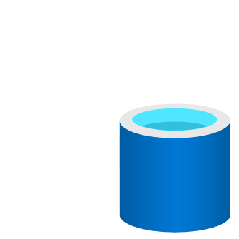
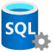
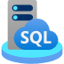









Bring your ideas to life with Azure
Limitless cloud database services
Unmatched analytics and insights
Unified data governance

Slide 3










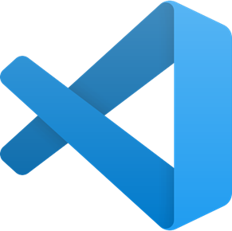





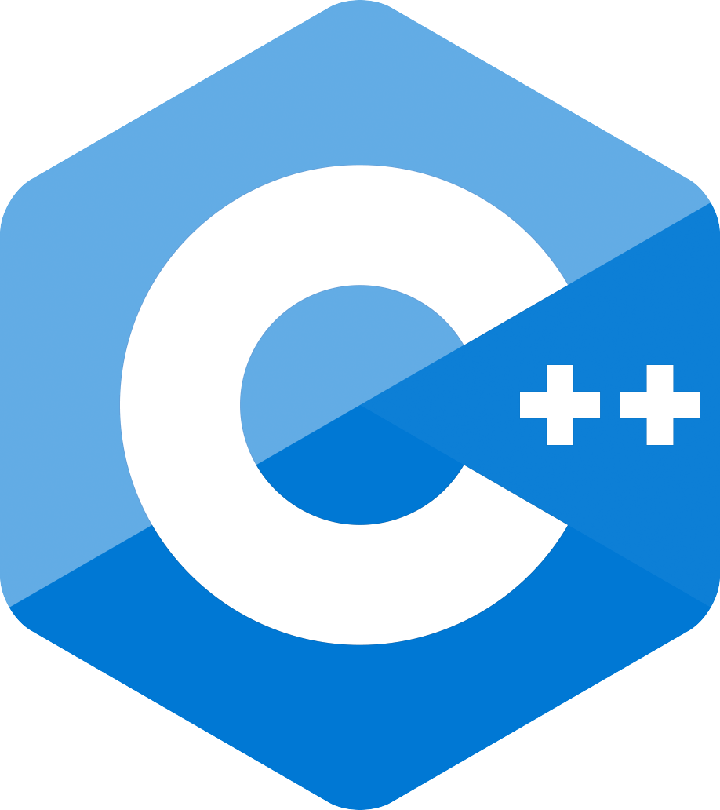


Open-source on Azure Run your applications your way while optimizing IT costs
Linux on Azure—fastest growing platform on Azure
Access enterprise-ready databases and analytics
Node.js
.NET
Flexibility of choice for modern app development
Ruby
Optimize Machine Learning
Enterprise-grade security and compliance
Notes:
With Azure, we are constantly providing capabilities that can help meet your needs to work with Open Source.
With the increase in open-source adoption, it is imperative that it runs smoothly on Azure.
On Azure you can run multiple apps and increase workload performance and security all while optimizing IT costs.
We want you to focus on building your application and not your infrastructure.
And we are excited to show you today how we are making Azure the best cloud for developers and IT decision makers

Slide 4
Be future-ready with Azure and open source
Leverage your favorite open source services on Azure with:
Seamless migration of Linux workloads
Support for modern development practices including Azure Kubernetes Service
Choice of fully managed open source database including MySQL, PostgreSQL and MariaDB
Compatibility with latest open source extensions and tools
Enjoy community-driven quality with a large developer network
Configuration
Easy set up
Scale
Limitless
Management
Less maintenance
Azure
OSS
Security
Always a step ahead
90% of enterprises deploy open source in some form
Notes:
Microsoft Azure is the cloud that lets you turn ideas into solutions with more than 100 services to build, deploy, and manage applications—in the cloud, on-premises, and at the edge—using the tools and frameworks of your choice. Our track record of continuous innovation supports your development today and your visions for tomorrow. Over the past year, we’ve launched over 1000 capabilities on the platform, helping our customers be future-ready. The cloud is moving fast – every week a new technology is coming out. So it’s about meeting new capabilities now and investing in those on the horizon.
In the world of data, we are committed to empowering organizations to build on their terms with flexibility and choice, and that includes the freedom to operate anywhere.
Nothing is more important than trust, particularly when you’re talking about the cloud. We spend $1B a year on cyber security with 3500 cyber security engineers who are constantly monitoring your data for threats. We’ve invested ahead of the curve in layers of security with built-in controls to protect your data and close the gaps that attackers can exploit. Trust your workloads to Azure, built upon the most secure cloud with the broadest compliance coverage.
Break through the resource constraints of modern application development with limitless scale that goes beyond other cloud providers.
Modernize existing apps or build new apps on Azure with built-in technologies that power new customer experiences.
Azure can help you innovate today, tomorrow, and in the future. We are constantly providing capabilities that can help meet your needs.

Slide 5
Choose the database you prefer
MySQL is a leading open source relational database for LAMP stack apps
MariaDB is a community-developed fork of MySQL with strong focus on the user community
v
Enhance your database of choice by uitilizing it as a fully managed service in Azure

Slide 6
Building next generation applications
From transforming products to building innovative web apps, developers use open source to push the envelope of what’s possible
Azure empowers developers with open source-driven services for apps, data, infrastructure and analytics
Azure Database for MySQL and MariaDB illustrate Microsoft’s commitment to open source
Notes:
Technology is omnipresent. It’s shaping how businesses plan for innovation and growth within their markets. The importance of digital transformation is urgent; Since 2000, 52% of Fortune 500 companies are gone due to digital disruption.
We see companies responding by creating digital strategies across four core areas: engaging their customers, empowering their employees, optimizing their operations, and transforming their products.

Slide 7





Azure Databases for MySQL Brings Azure innovation to your favorite community database
Cost effective, fully managed MySQL database
Easy to provision and scale
Build resilient and responsive mission critical applications
Develop and deploy applications faster with the power of Azure
Build on a trusted platform
Fully managed MySQL database with a 48% lower total cost¹ of ownership than on-premises deployments
Provision a database in less than 2 minutes. Easily scale your database with AI powered database monitoring
Optimize your application with query insights and performance tuning recommendations for your mission critical workloads.
Tap into the power of Azure by integrating with Azure Cognitive Services, Azure Kubernetes Service, or Azure App Service.
Deliver data-powered experiences with the security and privacy controls required to innovate with confidence.
Notes:
Azure Database for MySQL is a cost effective, fully managed MySQL database service in Azure which is easy to provision and scale. Customers and developers can focus on application development instead of managing the infrastructure, operating system, MySQL software, and so on.
Azure Database for MySQL works with PHP, Java, Python, Node.JS, Ruby, .NET, and applications can be hosted in Azure App Service, Azure Kubernetes Service, and Spring Cloud. There is also a great integration to other Azure services, including the end-to-end data platform and the AI services such as Cognitive Services which all can be used when building innovative, intelligent solutions.
Customers and developers will be able to build and deploy their data centric applications with the security and privacy controls required to innovate with confidence
¹ - aka.ms/mysqlflexibletco

Slide 8





Top use cases for Azure Databases for MySQL Flexible Server
Web apps using popular CMS
Build enterprise web apps using packaged apps such as Alfresco
Build Linux web apps quickly with Azure Database for MySQL and Azure App Service using WordPress and Drupal
Ecommerce platforms
Develop ecommerce applications including popular packaged such as Magento, Shopify
Gaming
Leverage high scale and reliability to build gaming applications with global scale and reach like Minecraft Realms
Mission critical line of business apps
Secure financial data workflows
Cloud-native apps
Build new custom apps in the cloud with Azure Kubernetes Service and Azure App Service
Notes:
One of the top use cases for Azure Database for MySQL Flexible Server is to build web applications using popular content management systems such as Alfresco, WordPress, Drupal, or Joomla.
Azure App Service is a hosting platform for web applications, REST APIs, and mobile back ends in Azure. App Service adds the power of Azure to your application, and has features for security, load balancing, autoscaling, and automated management. It allows you to host both Linux and Windows web applications, so if you are planning to build a website using WordPress, Drupal, or Joomla as the content management system, you can deploy a new website easily using Azure Marketplace and the deployment templates.
E-commerce is a very popular use case for MySQL, and there are even e-commerce platforms such as Magento, which provides a fast go-to-market experience for those developers and businesses who want to build a multi-channel commerce experience for customers on a single platform. Magento, also known as Adobe Commerce, is written in PHP, and can be easily deployed to Azure Kubernetes Service using Azure Marketplace and the pre-packaged container images. Conforming to security standards, such as PCI-DSS is very important in e-commerce, and these types of applications benefit from the security features we have in Azure, such as private networks, data encryption, Azure Firewall, Microsoft Sentinel, Microsoft Defender for Cloud, and so on.
Gaming is a very typical use case for Azure Database for MySQL and customers like Gamepub and Minecraft Realms keep their gamers happy with their fast and reliable database infrastructure and gaming platform in Azure.
Gamepub uses Azure Database for MySQL Flexible Server to have increased control and flexibility of database server parameters, more options for high availability, and cost optimization controls. With Flexible server they can reduce service downtime by aligning server maintenance with the game maintenance schedule.
Minecraft offers both single player and multiplayer modes of gameplay. Minecraft Realms enables players to create personal multiplayer servers, providing a private online multiplayer experience. Originally, Realms was completely hosted on AWS. This included the cloud-hosted multiplayer gamer servers, world state data storage, subscription and metadata databases, and the service code’s compute fabric.
Realms was migrated to Azure Database for MySQL for various reasons: They were looking for cost efficiency by moving from virtual servers to a true Platform-as-a-Service solution to shift focus away from managing virtual machines and to be able to spend more time enhancing the customer experience for their product offering. They were also looking for better interoperability with the Microsoft ecosystem, and to improve gameplay through a lower latency experience that could leverage the global footprint of Azure.
After Minecraft Realms moved its databases, compute, and storage to Azure, they achieved core tactical improvements for the business, including better cost efficiency and service maintainability while improving both the productivity of their developers and the gameplay experience.
Many financial companies and banks are using Azure Database for MySQL for payment and banking applications. A great example is HSBC, one of the world’s largest international banks, who combined the convenience afforded by smart phones with cloud services to allow cashless transactions where people can use their smart phone to perform payments digitally. Today, over one and a half million people use their PayMe app to exchange money with people in their personal network for free. And businesses are using HSBC’s new PayMe for Business app, built natively on Azure, to collect payments instantly, with 98 percent of all transactions completed in less than 500 milliseconds.
They use Azure Database for MySQL, a microservices architecture, and Azure services such as Azure Kubernetes Service, Azure Event Hubs, Azure Storage, Azure Cosmos DB, and Azure Databricks to build a full end-to-end solution.

Slide 9

Maximum control and flexibility to meet your workload needs with Flexible Server
Maximum control for your databases
Build resilient apps across availability zones
Simplified developer experience
Control planned downtime with custom maintenance windows
Network isolation with VNet integration and network security groups
Multiple configuration parameters for fine grained database optimization and tuning
Ensure data is always available with zone redundant high availability
Zero data loss within single and multiple availability zones
Guided developer experience increases productivity and simplifies end-to-end deployment
Full compatibility with community edition MySQL
Stop/Start and burstable capabilities for cost optimization

Slide 10





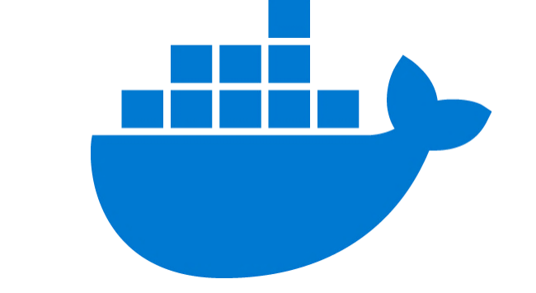

Get to market quickly with the LAMP open source stack
Scalable open source architecture using Azure App Service environment
Accelerate time to market by leaving database management to Azure Database for MySQL
Run an Azure Database for MySQL server side-by- side Azure App Service to simplify development
Integrate effortlessly with popular content management systems like WordPress, Drupal, and Joomla
Choose from many languages like PHP, Java, Node.js, and more
Ideal for web apps, digital marketing, and gaming
Azure Database for MySQL
v
Content Delivery Network
Azure App Service
Redis Cache
Monitoring/ Logging
Users
Docker Hub
Azure Database for MySQL provides a fully managed service that stores vast content as part of the Nobel Prize’s WordPress site
Notes:
https://customers.microsoft.com/en-us/story/nobel-media-media-telecommunications-linux-on-ase

Slide 11





Optimize performance for read-heavy workloads
Read-heavy workload architecture with read replicas
Increase performance by deploying read replicas, effectively isolating read and write workloads
Bring applications closer to users around the world by deploying read replicas to other Azure regions
Ideal for read-heavy workloads including BI reporting, social media, web apps, and analytics
SQL database
Read Replica #1
Power BI
v
Blob storage
Data Pipelines
Master server
Read Replica #2
Mobile app
Data Lake
Read Replica #3
Desktop app
Fotoable deploys photo-sharing apps around the world with Azure Database for MySQL servers deployed across Azure regions
Notes:
https://customers.microsoft.com/en-us/story/fotoable

Slide 12





Optimize app development with microservice architectures
Microservice architecture with Azure Database for MySQL and Azure Kubernetes Service
Easily integrate with AKS and other managed services for a quicker time to market
Quickly provision databases with microservices architectures and flexibly scale compute and storage
Easily integrate with Azure Kubernetes Service and other managed services to improve deploying and monitoring microservices
Ideal for retail, e-commerce, manufacturing, and banking applications
Azure Database for MySQL
Azure API Management
Azure Traffic Manager
Azure Kubernetes Service
Users
Azure Application Gateway
Azure Blob Storage
WhiteSource provides greater value to its customers by delivering new services faster and dynamically scaling database resources up and down
Notes:
WhiteSource case study: https://customers.microsoft.com/en-us/story/whitesource-simplifies-deployments-using-azure-kubernetes-service
Inspiration for architecture diagram: https://customers.microsoft.com/en-us/story/siemens-healthineers-health-provider-azure

Slide 13

Simplify migration and reduce database administration
Options for migrating to Azure Database Services
Free your team from database management by migrating on-premises and IaaS workloads to Azure Database for MySQL or MariaDB
Choose the migration approach that best fits the needs of your workloads
Reduce downtime on critical databases with Azure Database Migration Service*
Ideal for on-premises or IaaS MySQL or MariaDB databases
Discover and assess
DMS Continuous Sync
Azure Database Migration Service
Test
X
Connect to Azure with your favorite tool
Import/Export
Remediate apps
Optimize
Dump and store
Migrate schema and data
Gamepub reduced service downtime while simplifying failure prevention and analysis by migrating to Azure Database for MySQL Flexible Server
*Azure Database Migration Service is only available on Azure Database for MySQL

Slide 14

When to use Single Server vs. Flexible Server
When to use Single Server vs. Flexible Server
 | Flexible Server | Single Server
Database Version | MySQL 5.7, 8.0 | MySQL 5.7, 8.0
High Availability | Zone Redundant HA, Same zone HA (MySQL) | Built-in HA (Single-AZ)
Scheduled Maintenance | System or custom scheduled | System scheduled
Stop/Start |  | X
PITR
Network Isolation
Customer managed keys for Encryption
Reserved Instances (RI)
Cross region replicas
Uptime SLA | 99.99%* | 99.99%
*zone-redundant HA 99.99%
Notes:
Zone redundant – 99.99%
Same-zone – 99.95%

Slide 15
Using key features

Slide 16


Flexible Server Architecture
Region – East US
North Europe
West US 2
Availability Zone 1
Availability Zone 2
Flexible Server
AZ1
AZ2
Linux VM
AZ3
Azure VM
1
4
Availability Zone 3
AKS
Premium Storage
1
Linux VM
2
2
Premium managed disks (3 copies)
Data, Logs
App Service
3
Zone-redundant backup storage
3
Zone-redundant backup storage
4
AZ co-location with applications

Slide 17
Leverage your choice of versions, languages, and frameworks on a fully managed community database
Azure CLI
Azure Portal
Custom Mgt. App
Azure Resource Manager
Azure Database for MySQL is based on the MySQL community edition and supports versions 5.7 and 8.0
Azure Database for MariaDB is based on the MariaDB community edition and supports versions 10.2 and 10.3
Choose from a wide variety of compatible programming languages and drivers to facilitate development
Simplify database management with automatic updates, security fixes, and new feature updates
Azure Database Services Platform
Database tools
Application

Slide 18




Reduce administration through developer freedom with a fully managed service
Use Azure Portal, Azure CLI, or your custom management app and capitalize on features like:
Built in HA at no additional cost
Reliable performance and pay-as-you-go pricing with several service tiers
On demand scaling within seconds
Protected data at-rest and in-motion
Automated backup and point-in-time- restore for up to 35 days
Choose from a wide variety of compatible programming languages and drivers to facilitate development
Simplify database management with automatic updates, security fixes, and new feature updates
Azure CLI
Azure Portal
Custom Mgt. App
Azure Resource Manager
Azure Database Services Platform
Database tools
Application
Azure Database for MySQL is based on the MySQL community edition and supports versions 5.7 and 8.0
Azure Database for MariaDB is based on the MariaDB community edition and supports versions 10.2 and 10.3
Notes:
Quick start an Azure DB for MariaDB using Azure CLI:
https://docs.microsoft.com/en-us/azure/mariadb/quickstart-create-mariadb-server-database-using-azure-cli
Quick start an Azure DB for MariaDB using the Azure Portal:
Design an Azure DB for MariaDB using Azure CLI:
https://docs.microsoft.com/en-us/azure/mariadb/tutorial-design-database-cli

Slide 19
Protect against malicious action with Azure Defender
Azure Defender* uses Active Directory signals to identify and investigate user-based threats
After creating a behavioral baseline for each user, Azure ATP detects suspicious activity with built-in adaptive intelligence
Reduce vulnerabilities with configuration insights and suggested best-practices
Decrease alert noise with visibility to simple lateral movement paths and real-time attack timelines
Azure portal
Just turn it on
Azure Defender
Actionable alerts
Developer
Azure Security Center (ASC)
*Azure Defender only available for Azure Database for MySQL – Single Server
Notes:
ATP all up
https://docs.microsoft.com/en-us/azure-advanced-threat-protection/
ATP Sizing
https://docs.microsoft.com/en-us/azure-advanced-threat-protection/atp-capacity-planning

Slide 20





Protect data with layers of security and leading compliance
Native authentication
Azure Defender
Azure provides multiple layers of security to safeguard your data
Support for leading compliance offerings
Monitor access
Secure SSL connectivity
Server firewall rules
Virtual Network (SE)
Control access
Built-in encryption for data at rest and in motion
Protect data
Notes:
Compliance certifications available with Single Server. Certifications still under approval for Flexible Server

Slide 21
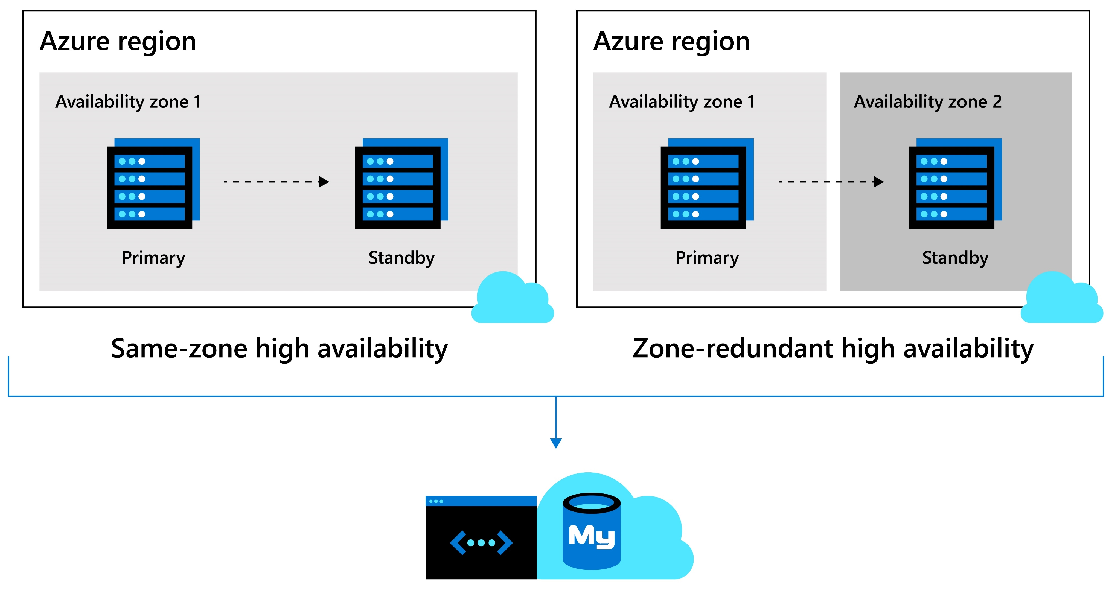
Built-in high availability
Build resilient, high-performance apps across availability zones
Ensure data is always available with either same-zone or zone-redundant high availability backed by industry-leading SLA’s
Automatic failover also ensures zero data loss within multiple availability zones
Fast automatic failover in 60-120 seconds

Slide 22
Optimize costs and lower total cost of ownership
Flexible pricing options
Reserved Capacity
Stop/Start functionality
Burstable compute SKUs
Scale compute, memory, and storage independently and pay only for what you use. Includes automatic database patching, query optimization, and security all at no extra cost
Choice of 1-year or 3-year Reserved Capacity pricing and save up to 60 percent compared to the regular pay-as-you-go payment options
Stop the MySQL server when it's not needed for up to 7 days. When the database is stopped, only pay for storage*
Utilize Burstable CPU credits for workloads that need extra performance during peak times*
No upfront cost. No termination fees. Pay only for what you use.
*Only available for Azure Database for MySQL – Flexible Server

Slide 23
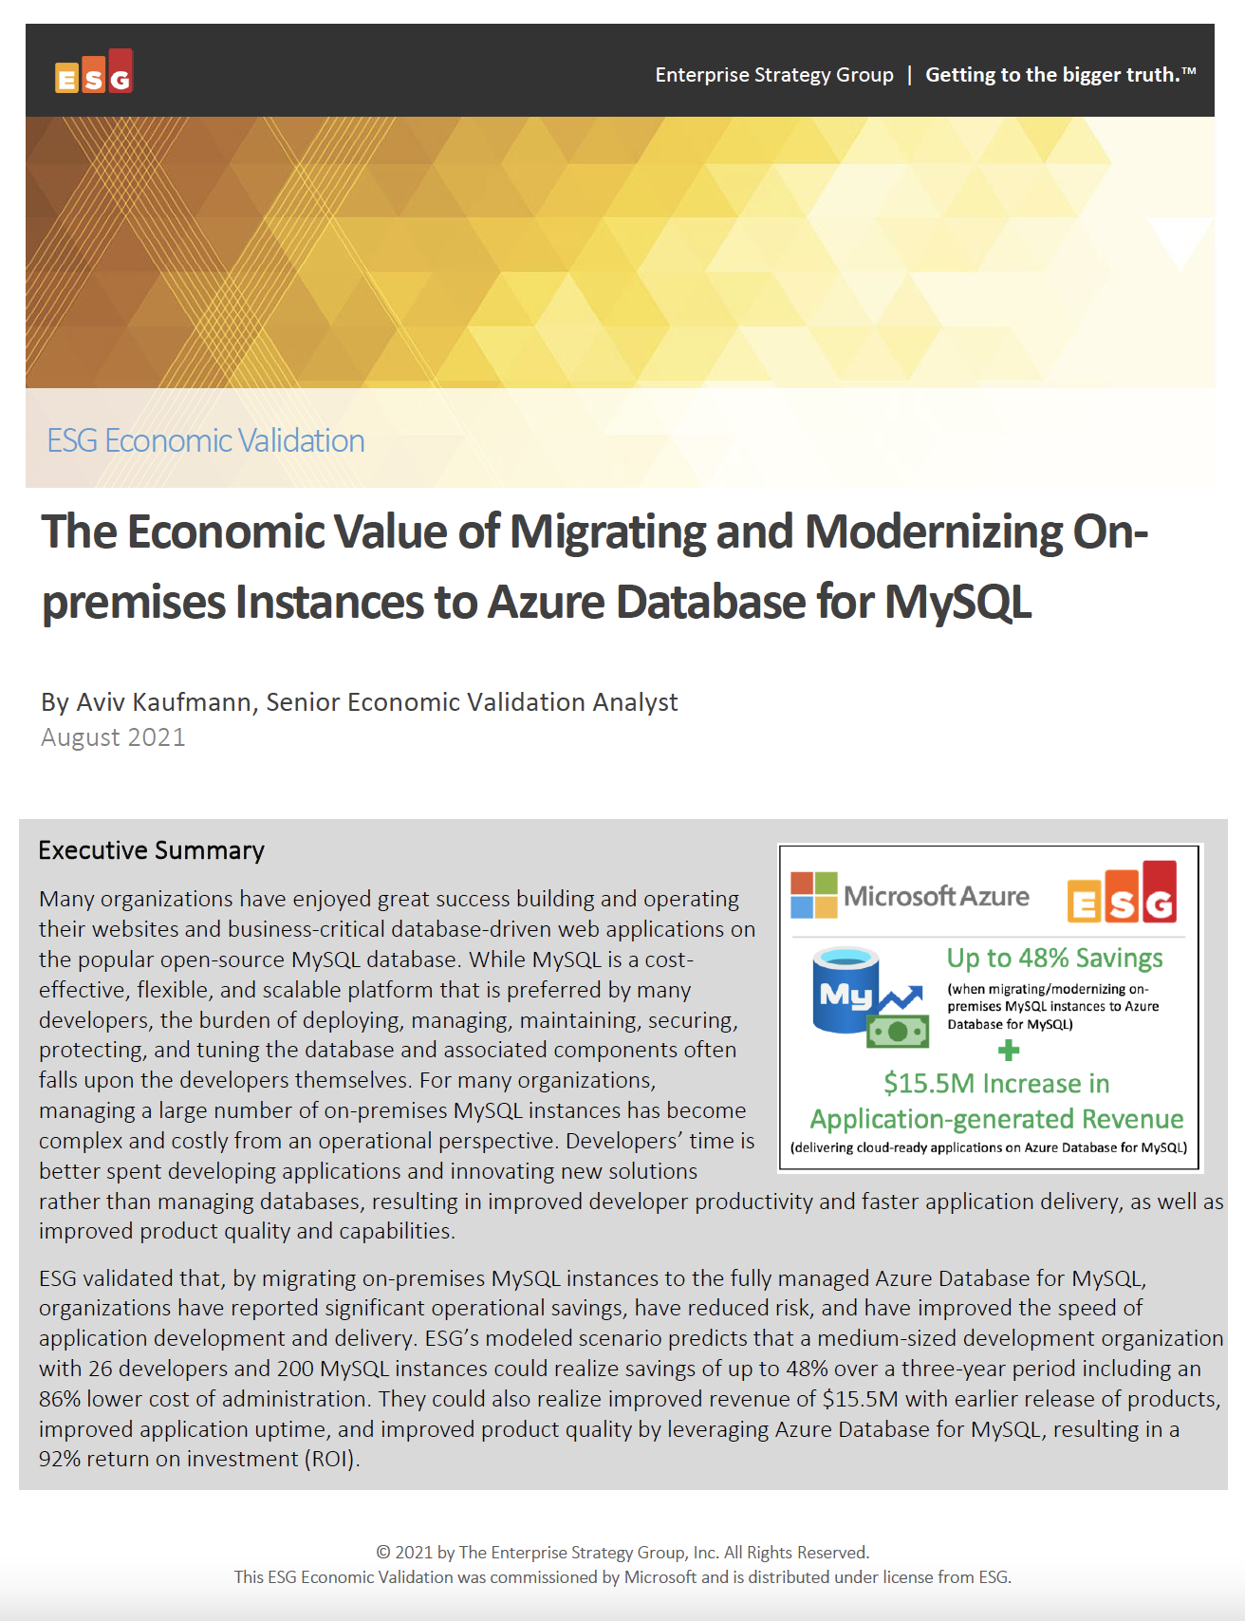
Significantly reduce cost when migrating workloads to PaaS
Key report benefits and findings¹
Up to 48%
Cost savings when migrating on-premises MySQL instances to Azure Database for MySQL
Microsoft commissioned Enterprise Strategy Group to conduct an Economic Value study to examine potential cost savings and business benefits enterprises would achieve from migrating on-premises workloads to Azure Database for MySQL.
Modernizing on Azure Database for MySQL yields even greater benefits…
+$15.5M
Additional revenue due
to faster time to market
93%
Reduction in
operational cost
92%
ROI expected over
the first year
86%
Lower cost of systems administration
1 Results are based on interviewed customers. “The Economic Value of Migrating and Modernizing On-premises Instances to Azure Database for MySQL,” a commissioned study conducted by The Enterprise Strategy Group on behalf of Microsoft, September 2021.
Notes:
We partnered with the Enterprise Strategy Group to validate the cost savings, operational efficiency, and improved business agility that customers reported when migrating their on-premises MySQL instances to Azure Database for MySQL Flexible Server and the TOP-LEVEL FINDINGS from ESG’s model FOUND THAT Azure Database for MySQL provided UP TO a 48% LOWER TOTAL COST over a three-year period to deliver the services to host, secure, and protect MySQL instances.
This included an enormous 93% reduction in the operational cost to deploy, manage, and maintain MySQL instances on an on-premises environment. Azure Database for MySQL offloads the majority of the work currently performed by developers, which reduces the EXPECTED cost to administer, tune, secure, protect, and maintain the MySQL databases by UP TO 86%.
These savings equate to roughly 4 full-time developers’ worth of PRODUCTIVITY SAVED, which equates to a 20% increase in development capacity, resulting in $15.5M dollars in additional expected revenue for the organization.
This is a perfect example of how Azure managed open source databases can reduce your total cost of ownership when migrating your workloads to Azure.

Slide 24
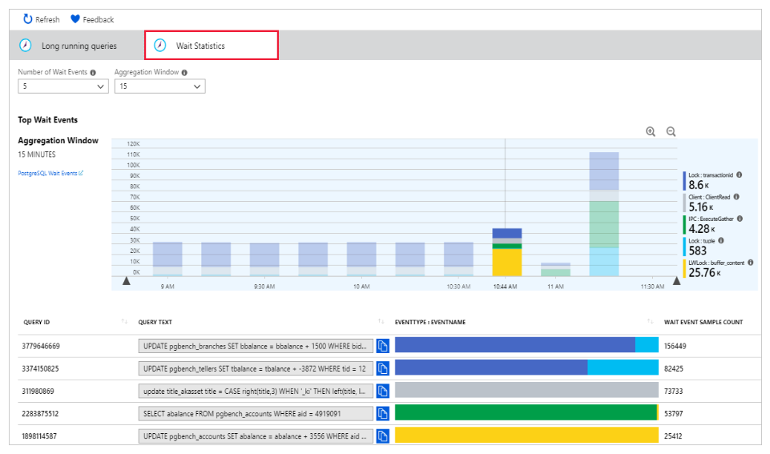
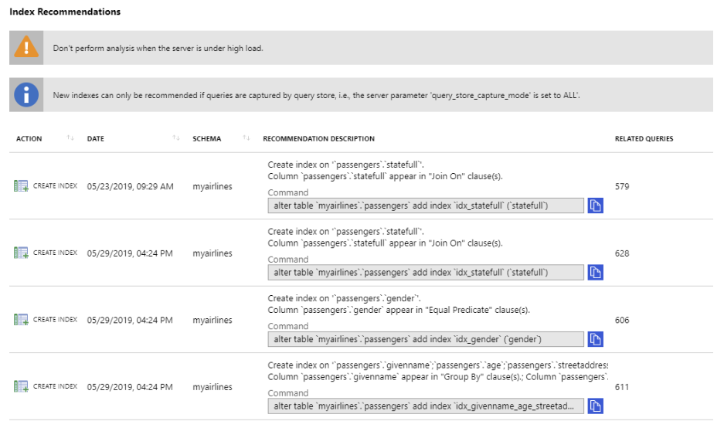
Query Performance Insight and Performance Recommendations
Wait statistics in Query Performance Insight
Query Performance Insight allows you to quickly identify the longest running queries, how they change over time and what waits are affecting them
The Query Performance Insight view in the Azure portal surfaces visualizations on key information from Query Store
The long running queries tab shows the top queries by average duration per execution, aggregated in 15-minute intervals
Users can view additional queries and alter the time window
Performance Recommendations analyzes your MySQL and MariaDB databases to create customized suggestions for better performance
Create Index recommendations suggest new indexes to accelerate the most frequently run or time-consuming queries
Azure portal performance recommendations
Notes:
Query Store simplifies performance troubleshooting by helping you quickly find the longest running and most resource-intensive queries
Query Performance Insight helps you to quickly identify what your longest running queries are, how they change over time, and what waits are affecting them.
The Performance Recommendations feature analyses your databases to create customized suggestions for improved performance

Slide 25





Innovate with the Azure ecosystem
Easily spin up a database for popular Java, Python and php based applications through Azure Kubernetes Service or Azure App Service
Leverage GitHub actions to deploy updates to your database by enabling simpler and faster innovation with integrated Azure technologies
Develop applications with platforms like Magento, Shopify, Moodle, Alfresco, Drupal and WordPress

Slide 26
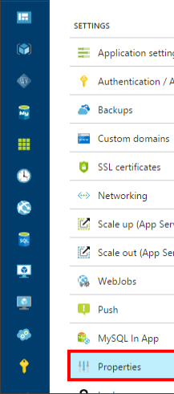
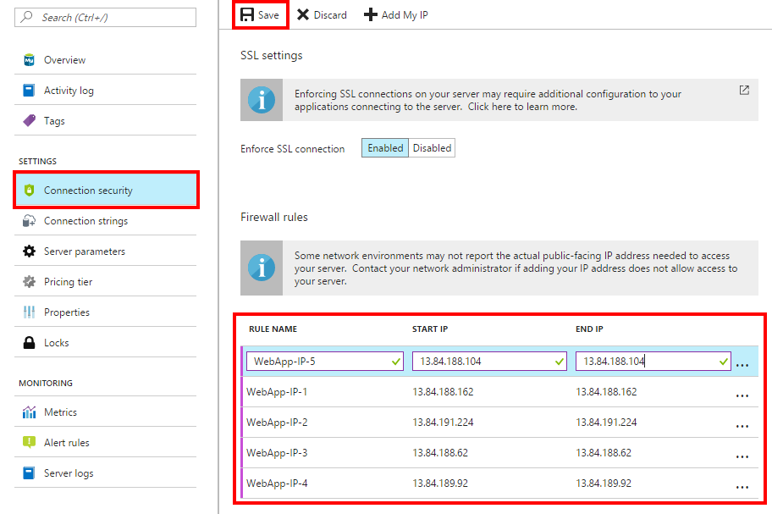
Innovate and build apps faster with the Azure ecosystem
Simple database connection to Azure App Service
Easily spin up a database for popular Java, Python and php based applications through Azure Kubernetes Service or Azure App Service
Leverage GitHub actions to deploy updates to your database by enabling simpler and faster innovation with integrated Azure technologies
Deploy the power of Azure by integrating with Azure Cognitive Services, Azure Kubernetes Service, or Azure App Service
Accelerate time to market with LAMP stack
Best-in-industry protection from intellectual property risks with the Azure IP advantage

Slide 27
Migration resources

Slide 28
Two options to migrate to Azure Database for MySQL or MariaDB
Recommended approach
Option 1
Azure Database Migration Service*
Minimize downtime with continuous sync
Recommended for full database migrations and in-production applications
Option 2
Proof of concept migration
Use dump and restore or import/export for faster migrations
Recommended for testing and proof of concept scenarios only
mysqldump + restore
*Azure Database Migration Service is only available on Azure Database for MySQL

Slide 29
Resources for migration
Azure Database for MySQL Migration Guide https://aka.ms/mysqlmigrationguide
Azure Database Migration Service Migrate with minimum downtime http://aka.ms/get-dms
Microsoft Azure
Azure Database Migration Service
On-premises workloads
Notes:
Migration guide
Provides prescriptive guidance on how to do migrations. Customers have access to case studies of migrations that other customers already did. Customers will also find a list of partners that they can contact to get assistance to do migrations.
DMS
As organizations look to optimize their IT infrastructure to have more time and resources to focus on business transformation, Microsoft is committed to accelerating these initiatives. The new Azure Database Migration Service (DMS) is a fully managed, first party Azure service that enables seamless and frictionless migrations from heterogeneous database sources to Azure Database platforms with minimal downtime. This service will streamline the tasks required to move existing competitive and SQL Server databases to Azure.
Seamlessly migrate on-premise databases at scale
Experience near zero downtime for mission critical applications
Trust in a robust, resilient service for every migration scenario
Migrate multiple database sources to Azure
*Using DMS to migrate MySQL to Azure Database for MySQL will be at private preview during Azure Database for MySQL GA.
Migrate with minimum migrations
Uploading a large amount of data to the cloud takes some time. Customers cannot always tolerate to stop the application while the database is being migrated. Both DMS and Attunity Replicate For Microsoft Migrations allow customers to migrate with minimum application downtime. The way it works is: while the migration is happening, the data - that users change when using the application- is replicated to the target. The mount of application downtime that customers take is reduced to the time it takes them to points the application to the target (change the connection string, change the definition of the DMS alias…).

Slide 30
Minimize downtime using Database Migration Service
Migrate initial load
New transactions continue to replicate to target until data catches up
Stop new traffic coming in (downtime started)
Wait for last batch of data to catch up
Complete DB migration
Update connection string (back online)
DMS Continuous Sync
Notes:
I have a retail application hosting on on-premise MySQL or Postgres or MariaDB. I setup DMS pipeline to start the migration to move data from source which is my on-premise to target which is Azure Database for MySQL or Postgres. Under the hood, what DMS is doing is migrating the initial load to target. Any new transactions that come in after the initial load will continue to replicate to target until data catches up on the target side.
When the developer is satisfied with the data being sync on the target, what he will do is to stop new traffic from coming into the application. Usually he or she will set the application on maintenance mode, and this stops the new transactions from coming in. We will wait for DMS to catch up and replicate the last batch of data. At this point, target is completely in-sync with the source. Developer will complete the database migration in DMS side and simply update the connection string of the application and point to Azure.
There you have it! Your application now is running live pointing to Azure Database for Postgres or MySQL.

Slide 31
Outperform the competition with Azure Database for MySQL and MariaDB
Cloud HA and scaling | Performance and security
Built-in high availability (HA) and elastic scaling to save time and money with a 99.99% SLA | Enterprise-grade performance and security from Intelligent Performance and Azure Defender
Azure integration | Truly global reach
Seamless integration with Azure App Service and one-click connections to the Azure ecosystem | 2x global reach vs. AWS RDS

Slide 32
Call to action
Assess which workloads will benefit from Azure Database for MySQL and MariaDB
Connect with your Microsoft representative to learn more
Try Azure Database for MySQL for free

Slide 33
Documentation and resources
Gear Up landing page: https://aka.ms/OSS_DB
MySQL documentation: http://aka.ms/mysqldocs
MariaDB documentation: https://aka.ms/mariadbdocs
Ask Questions: AskAzureDBforMySQL@service.microsoft.com AskAzureDBforMariaDB@service.microsoft.com
MySQL & MariaDB Videos: https://aka.ms/mysql-azure-videos

Slide 34
Objection handling
Objection | Response
Will I end up paying more with managed service if I’m moving form IaaS or on-premises? | No, you will most likely pay less. IaaS and on prem servers are traditionally over built to handle spikes in workload. Azure Database Services for MySQL and MariaDB allow you to provision in line with your typical workloads but offer the ability to scale-up on the fly as workloads increase. HA is built in with no need for extra replicas.
Will I need to rebuild my app? | No, Azure Database Services are built around the community database engines of MySQL and MariaDB. If your app works outside of Azure, moving to Azure will be painless.
Will I be able to move off of Azure? | Yes, by utilizing the community versions of MySQL and MariaDB you will not be locked into the service and can leave Azure with community tools
Why should I choose Azure for my workloads vs. Amazon, Google, and others? | Competitor cloud vendors not offer indemnification of intellectual property for open source workloads. Microsoft offers the Azure IP Advantage program to protect against lawsuits.
How difficult will it be to move my app to the cloud? | No code changes are necessary to move existing applications to Azure IaaS. Zero downtime is achievable by doing an online migration using Azure Database Migration Services.
MICROSOFT CONFIDENTIAL

Slide 35
Azure Database for MySQL vs. Google Cloud SQL for MySQL
TCO comparison
Azure vs. GCP Standalone Instances (No HA)
The following scenarios compare Azure Database for MySQL 8 vCore instances to non-HA (“standalone instance”) GCP 8 vCore instances with 1 TB of storage:
Azure MySQL 8 vCore General Purpose vs. GCP MySQL db-n1-standard-8
Azure MySQL 8 vCore Memory Optimized vs. GCP MySQL db-n1-highmem-8
Azure (HA) vs. GCP HA² Instances
The following scenarios compare Azure Database for MySQL 8 vCore instances to HA² GCP 8 vCore instances with 1 TB of storage:
Azure MySQL 8 vCore General Purpose vs. GCP MySQL db-n1-standard-8
Azure MySQL 8 vCore Memory Optimized vs. GCP MySQL db-n1-highmem-8
55% savings vs. AWS
57% savings vs. GCP
15% savings vs. GCP
11% savings vs. GCP
Total Monthly Cost:
Monthly storage costs
Monthly compute costs
¹TCO calculated from prices as of October 23, 2018. Assumed 744 hours per month
²GCP only provides high availability (“HA”) when a failover replica is enabled, which is a second instance that effectively doubles a customer’s monthly costs
³GCP has a lower memory to compute ratio than Azure: Azure GP offers 5 GB memory per vCore where as GCP provides 3.75 GB memory per vCPU; Azure MO is 10 GB memory per vCore vs. 6.5 GB per vCPU for GCP highmem instances

